Slide 1

  Chapter Two
  Embedded System Architecture

Slide 2

Module Outline
Hardware architectures for embedded systems
ARM Cortex M0+ Hardware Overview
Communication: Parallel, USB/Serial, USART, SPI, TWI, Ethernet,
ATmega32 microcontroller Architecture
Assembly language Programming with ATmega32 Instruction Set (Lab session)
Programming in C to Interface peripherals, Interrupts, ISR and Timers (Lab Session)

Slide 3
An Introduction to Embedded Systems Architecture
The architecture of an embedded system is an abstraction of the embedded device, i.e., it is a generalization of the system that doesn’t show detailed implementation such as software source code or hardware circuit design.
At the architectural level, the hardware and software components in an embedded system are represented as some composition of interacting elements.
Elements are representations of hardware and/or software whose implementation details have been abstracted.
Architecture-level information is physically represented in the form of structures.
A structure is one possible representation of the architecture, containing its own set of represented elements, properties, and inter-relationship information.
A structure is therefore a “snapshot” of the system’s hardware and software at design time and/or at run-time, a given a particular environment and set of elements.

Slide 4
Cntd…
The architecture of an embedded system is centered around its microcontroller, also sometimes referred to as the micro controller unit (MCU).
Single integrated circuit containing the processor, RAM, flash memory, serial receivers and transmitters, and other core components.
The market offers many different choices among architectures, vendors, price range, features, and integrated resources.
These are typically designed to be inexpensive, low-resource, low-energy consuming, self-contained systems on a single integrated circuit, which is the reason why they are often referred to as System-on-Chip (SoC).
Due to the variety of processors, memories, and interfaces that can be integrated, there is no actual reference architecture for microcontrollers.

Slide 5
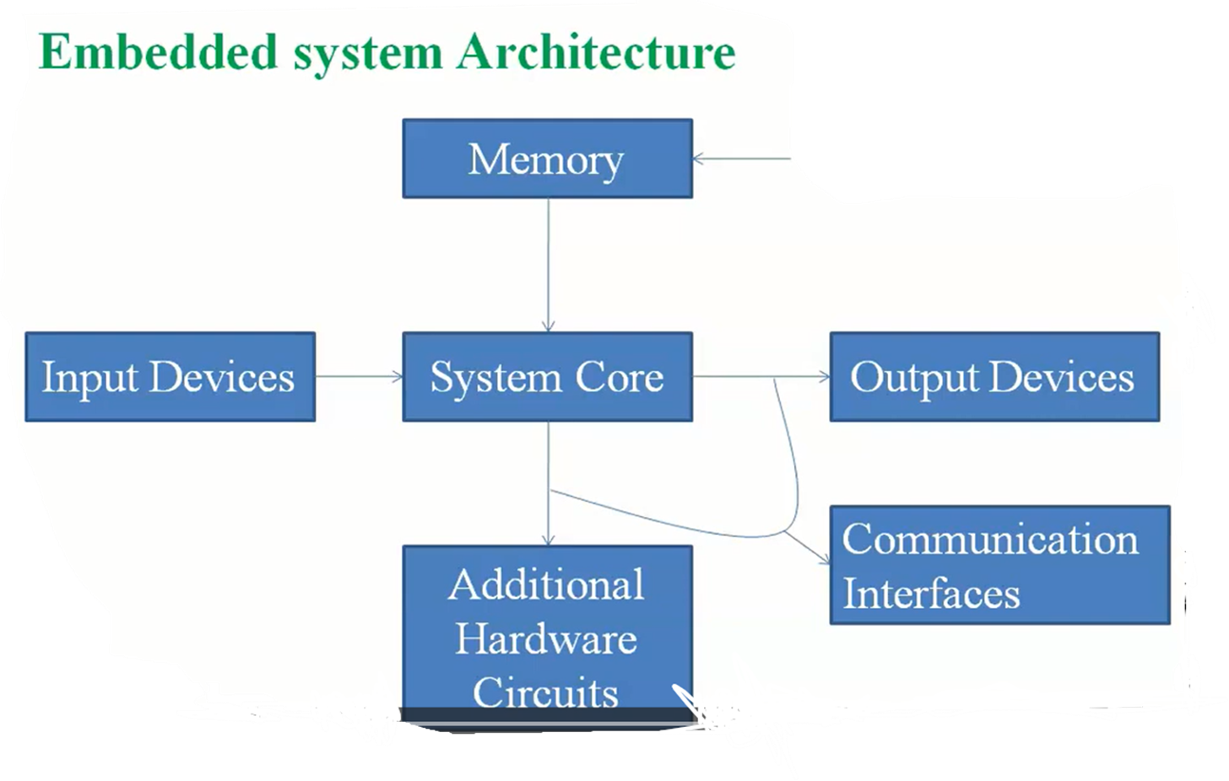
Cntd…

Slide 6
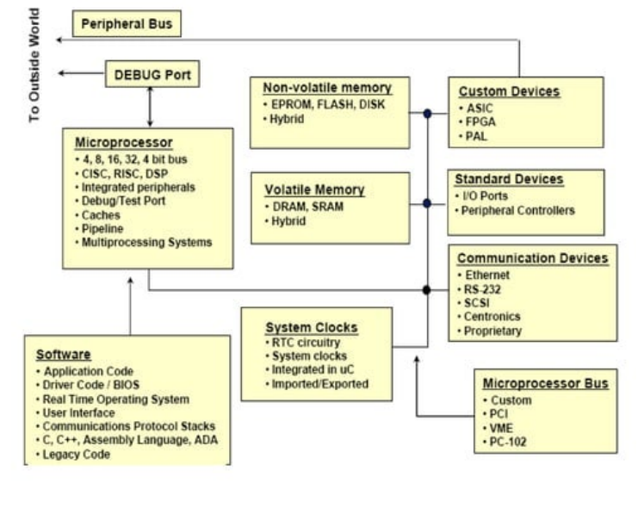
Cntd…
Typical architecture
Notes:
Tamper= interfere

Slide 7
Cntd…
1. Microprocessor: it is the heart of any Real Time Embedded System (RTES).
The microprocessors used here are different from the general purpose microprocessors.
They are designed to meet some specific requirements.
For e.g., Intel 8048 is a special purpose microprocessor which you will find in the Keyboards of your Desktop computer. Similarly mobile phones Digital Cameras, washer and dryer may use some other type of processor.
2. Memory:
The microprocessor and memory must co-exit on the same Power Circuit Board (PCB) or same chip.
Compactness, speed and low power consumption are the characteristics required for the memory to be used in an RTES.
Very low power semiconductor memories are used in almost all devices.
The memory should be capable of storing the information even after the power is removed. should be non-volatile and should be easily programmable.

Slide 8
Cntd…
3. Input Output Devices and Interfaces
I/O interfaces are necessary to make the RTES interact with the external world.
They could be Visual Display Units in a mobile phone, touch pad, speakers etc.
These I/O devices along with standard software protocols in the RTOS provide the necessary interface to these standards.
There are many device that embedded system used to communicate to the outside environment. e.g., Custom Device, standard device, communication device etc.
Custom Device
i. PAL (Programmable Array Logic): It is the first widely used device.
  It is used to implement logic functions in digital circuits.
  PAL devices consisted of a small PROM core and additional output logic.
ii. FPGA (field programmable gate array):
  These chips are manufactured for general use.
  This means you can program and reprogram.
  FPGAs after they have left the manufacturer and are being used in the field.

Slide 9
Cntd…
iii. ASIC (application specific integrated circuit): an ASIC microchip is designed and manufactured for one specific application and doesn’t allow you to reprogram or modify it after it is produced.
This aren’t intended for general use.
4. Software
The RTES is the just the physical body as long as it is not programmed.
It is like the human body without life. Whenever you switch on your mobile telephone you might have marked some activities on the screen.
Whenever you move from one city to the other you might have noticed the changes on your screen.
These activities are taken care of by the RTOS sitting on the non-volatile memory of the RTES.
Besides the above an RTES may have various other components and Application Specific Integrated Circuits (ASIC) for specialized functions.

Slide 10
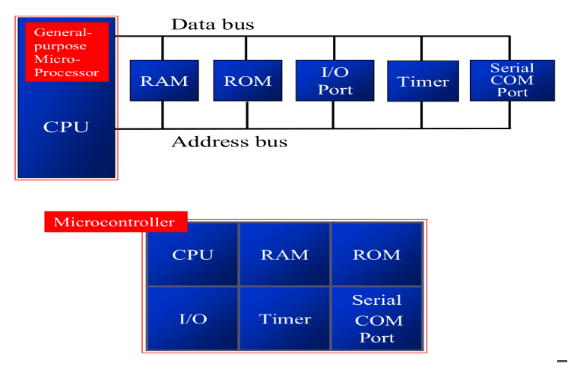
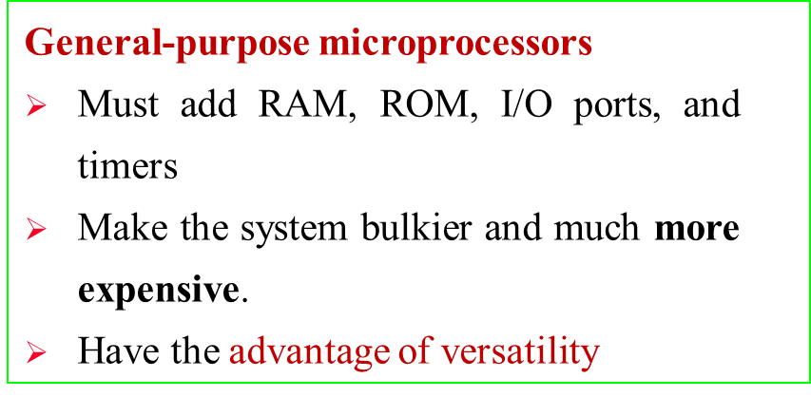
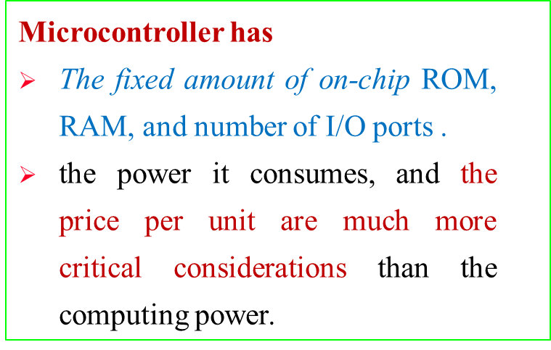
General-Purpose Microprocessor vs Microcontroller
Figure: General-Purpose Microprocessor vs Microcontroller

Slide 11
Embedded Systems - Architecture Types
There are two basic types of architecture:
    Von Neumann and
    Harvard
A. Von Neumann Architecture
Von Neumann architecture has a single, common memory space where both program instructions and data are stored.
There is a single data bus which fetches both instructions and data.
Each time the CPU fetches a program instruction it may have to perform one or more read/write operations to data memory space.
It must wait until these subsequent operations are complete before it can fetch and decode the next program instruction.
The advantage to this architecture lies in its simplicity and economy

Slide 12
Cntd…
B. Harvard Architecture
Harvard architecture computers have separate memory areas for program instructions and data.
There are two or more internal data buses which allow simultaneous access to both instructions and data.
The CPU fetches instructions on the program memory bus.
If the fetched instruction requires an operation on data memory, the CPU can fetch the next program instruction while it uses the data bus for its data operation.
This speeds up execution time at the cost of more hardware complexity.
Microcontrollers most often use a Harvard or a modified Harvard-based architecture.

Slide 13
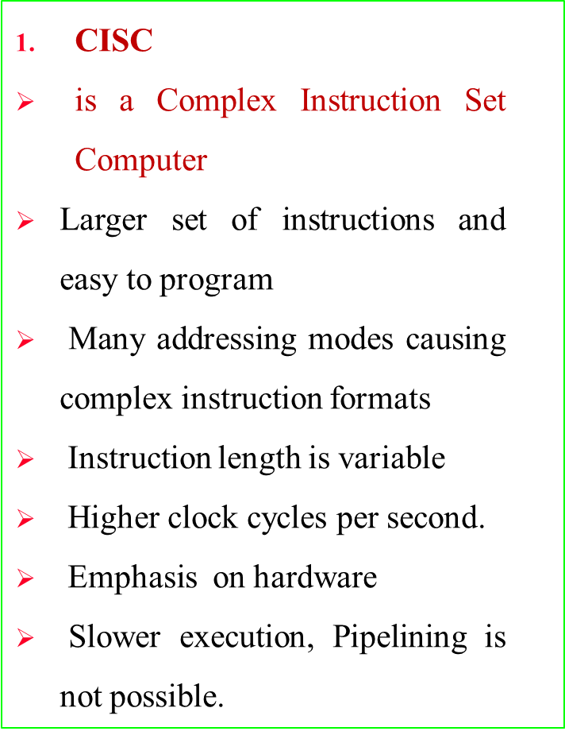
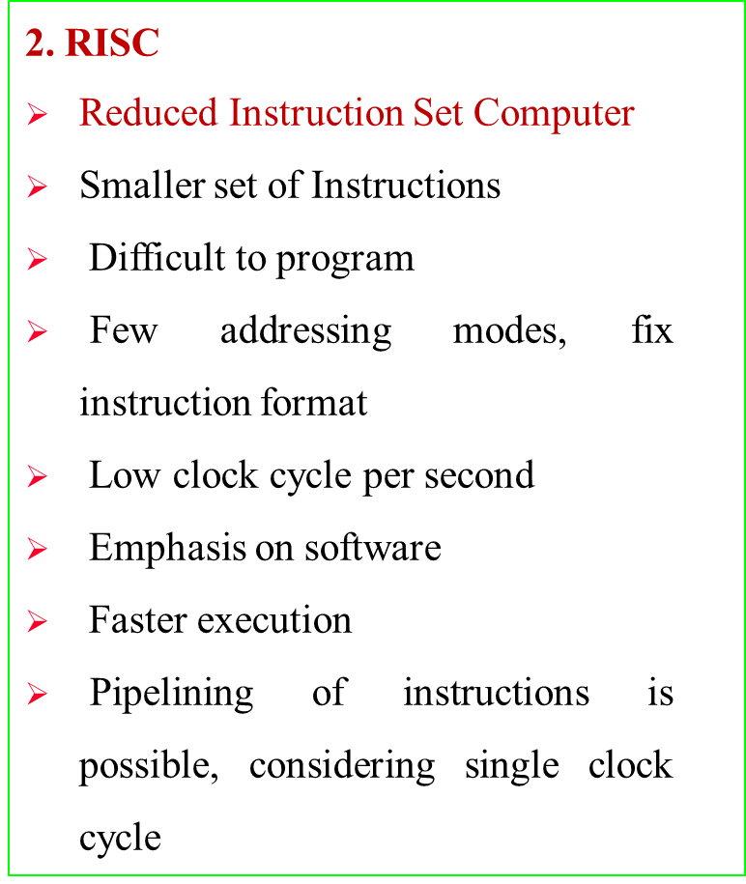
Cntd…
Based of instruction Set:

Slide 14
ARM Cortex M0+ Hardware Overview
ARM is Advanced RISC Machine and founded in November 1990
The ARM Cortex-M is a group of 32-bit RISC ARM processor cores.
It is licensed by ARM company.
It is the most energy-efficient Arm processor and low cost available for embedded applications with design constraints.
It is the architecture for the digital world not a product
It features one of the smallest silicon footprint and minimal code size to allow developers to achieve 32-bit performance.
It integrates a Memory Protection Unit (MPU), a single cycle I/O interface and a Micro Trace Buffer (MTB).
What is the difference b/n intel CPU& ARM Cortex ?

Slide 15
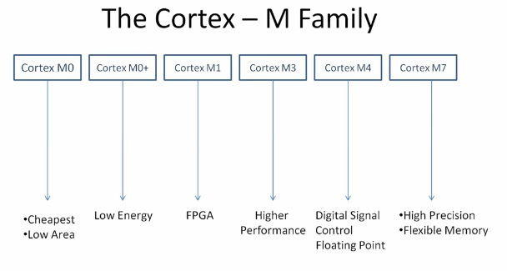
Cntd…

Slide 16
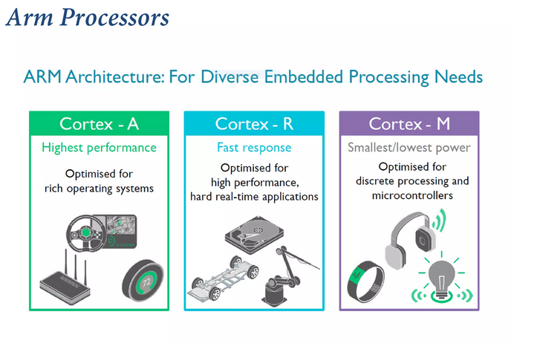
Cntd…
ARM processors offer a variety of capabilities for different purposes.
Depending on the level of performance you need, you can choose between the Cortex-A, Cortex-R, or Cortex-M categories of high-level processors.

Slide 17
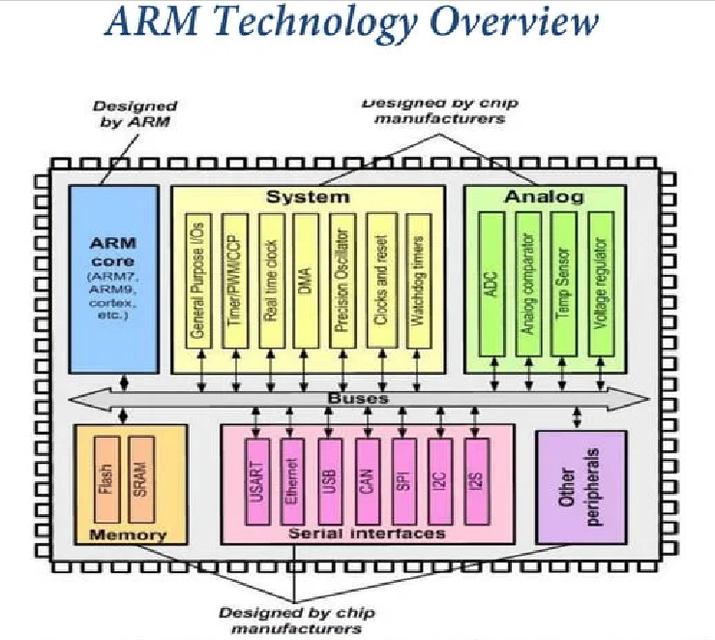
Cntd…

Slide 18
Cntd…
Key features of Arm Cortex-M0+ core
  High performance 32-bit CPU
  2.42 CoreMark/MHz – 0.93 MIPS/MHz
  Low latency 2-stage pipeline
  Several sleep modes, with integrated Wait For Interrupt (WFI) a Wait for Event (WFE) plus sleep on exit capability, sleep and deep sleep signals
  Optional Micro Trace Buffer
  Von Neumann bus architecture with optional single cycle I/O interface
  Non-maskable interrupt + 1 to 32 physical interrupts.

Slide 19
Embedded Communication
Embedded systems often communicate with outside systems in a device, enabling data exchange and control functions.
Serial communication: it is the process of sending/receiving data in one bit at a time.
It is like you are firing bullets from a machine gun to a target. i.e. one bullet at a time!
E.g. of serial communication protocols ethernet, I2C, SPI, USB, and SATA etc.
Parallel communication: it is the process of sending/receiving multiple data bits at a time through parallel channels.
It is like you are firing using a shotgun to a target, where multiple bullets are fired from the same gun at a time!.
E.g. parallel communication protocols are
  Industry Standard Architecture (ISA),
  Analog telephony Adaptor (ATA),
  Small Computer System Interface (SCSI),
  Peripheral component interconnect (PCI) ...
Notes:
ISA (Industry Standard Architecture) ATA (Analog telephony Adaptor) PCI [Peripheral component interconnect]

Slide 20
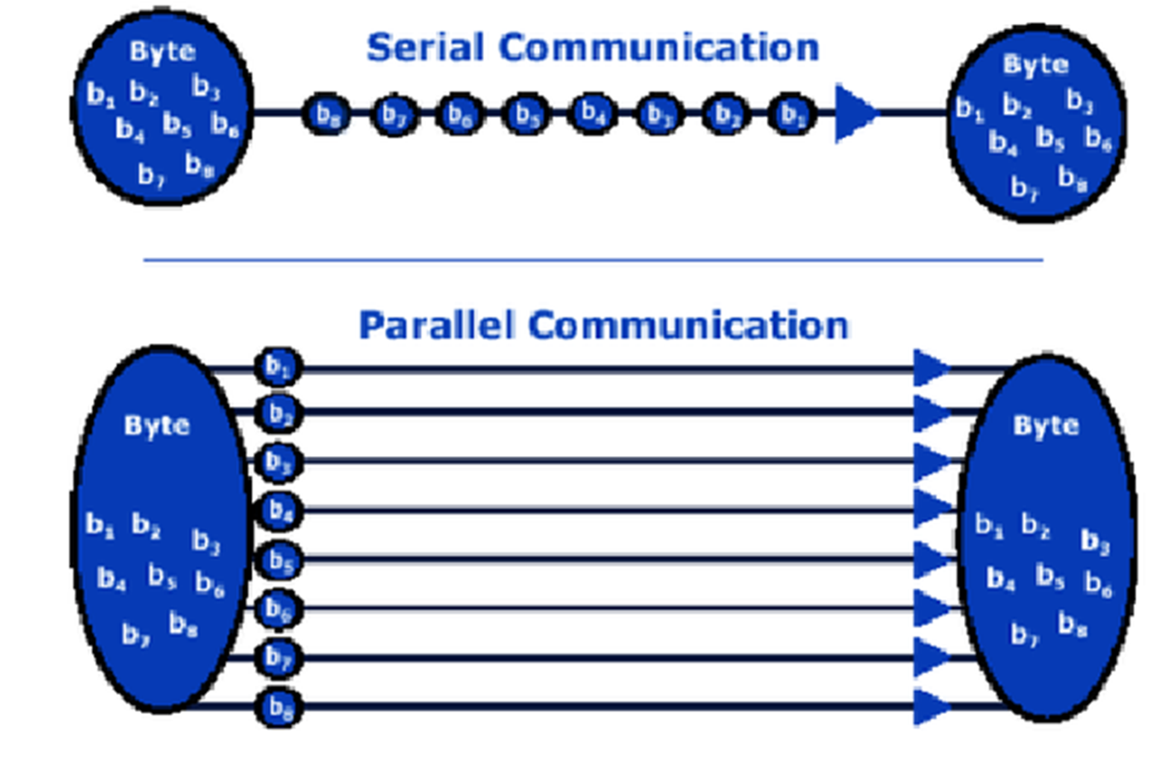
Contd…
Notes:
ISA (Industry Standard Architecture) ATA (Analog telephony Adaptor) PCI [Peripheral component interconnect]

Slide 21
Cntd…
A. Serial Communication Protocols:
A variety of communication protocols have been developed based on serial communication in the past few decades.
Some of them are:
Universal Synchronous and Asynchronous Receiver and Transmitter (USART)
It is a serial communication for two protocols.
It is used for transmitting and receiving the data bit by bit over a single wire with respect to clock pulses.
The peripheral interface controller (PIC) microcontroller has two pins serial data transmitter pin (TXD) and serial data receiving (RXD) pin.
These pins are used for transmitting and receiving the data serially.

Slide 22
Cntd…
2. Serial Peripheral Interface (SPI ) protocol: This protocol is used to send data between peripheral interface controller (PIC) microcontroller and other peripherals such as SD cards, sensors and shift registers.
PIC microcontroller support three wire SPI communications.
One wire each for Master to slave and Vice-versa, and one for clock pulses.
There is an additional SS (Slave Select) line, which is mostly used when we want to send/receive data between multiple ICs.
The data rate of SPI protocol is more than that of the USART.
3. Inter Integrated Circuit (I2C) Protocol: Pronounced eye-two-see.
It is an advanced form of USART.
It is used to connect low speed devices i.e., EEPROMs, microcontrollers, etc.
The transmission speeds can be as high as 400KHz.
The I2C bus has two wires: one for clock, and the other is the data line, which is bi-directional. the reason it is also sometimes called Two Wire Interface (TWI).

Slide 23
Cntd…
4. FireWire:
Developed by Apple,
They are high-speed buses capable of audio/video transmission.
The bus contains a number of wires depending upon the port, which can be either a 4-pin one, or a 6-pin one, or an 8-pin one
5. Ethernet: Used mostly in LAN connections, the bus consists of 8 lines, or 4 Tx/Rx pairs.
6. Universal serial bus (USB):
This is the most popular of all.
It is used for virtually all type of connections.
The bus has 4 lines: VCC, Ground, Data+, and Data-
“Parallel communication protocols are your reading assignment”

Slide 24
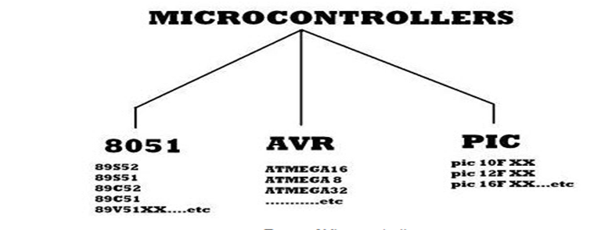
Types of Microcontroller
A microcontroller is a functional computer system-on-a- chip.
It contains a processor, memory, and programmable input/output peripherals.
1. 8051 Microcontroller
Intel created 8051 microcontrollers in 1981.
It is an 8 bit microcontroller.
It consists of are four parallel 8 bit ports, which are programmable as well as addressable as per the specification.

Slide 25
Cntd…
2. AVR Microcontroller
AVR stands for Alf and Vegard's RISC Processor.
It was the modified Harvard architecture machine, where program and data were stored in the separate physical memory system.
3. Advanced RISC Machine (ARM) Microcontroller
It’s the most popular Microcontrollers Programming in the digital embedded system world
Most of the industries prefer only ARM microcontrollers since it consists of significant features to implement products with an excellent appearance.
It is cost sensitive and high-performance device.

Slide 26
Cntd…
4. Peripheral Interface Controller (PIC) Microcontroller
It is a kind of microcontroller components used in the development of electronics, computer robotics, and similar devices.
PIC was produced by Microchip technology and based on hardware computing architecture.
The code and data are placed in separate registers to increase the input and output.
What are other micro controllers and explain in detail? (reading Assignment )

Slide 27
ATmega32 microcontroller Architecture
ATmega32 means AT is Atmel, mega is 10⁶, 32 is number of ports that it has.
ATmega32 is a low power CMOS 8-bit microcontroller based on the AVR enhanced RISC architecture.
Atmel Corporation is a manufacturer of semiconductors, founded in 1984.
Atmel introduced the first 8-bit flash microcontroller in 1993.
Its products include microcontrollers , and its own Atmel AVR and AVR32 architectures.

Slide 28
Cntd…
Key Features:
  32 x 8 general working purpose registers.
  32K bytes of in system self programmable flash program memory
  2K bytes of internal SRAM and 1024 bytes EEPROM
  Available in 40 pin dual in line package (DIP) and 32 programmable I/O lines
  8 Channel, 10 bit ADC
  Two 8-bit and one 16 timers/counters with separate pre scalers and compare modes
  4 pulse width modulation (PWM) channels
  In system programming by on-chip boot program
  Programmable watch dog timer with separate on-chip oscillator.
  Programmable serial USART
  Master/slave SPI serial interface
Notes:
the watchdog timer watches the program. Its job is to monitor the CPU to ensure that there are no faults occurring at a stage in the system. If the watchdog happens to detect an error, it immediately sends a signal to reset the CPU.

Slide 29

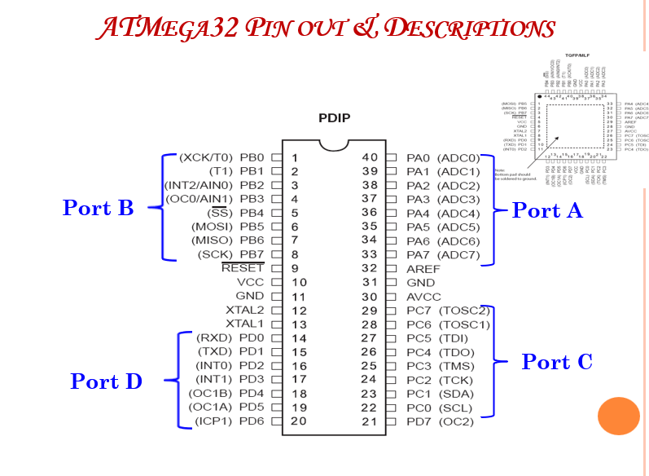
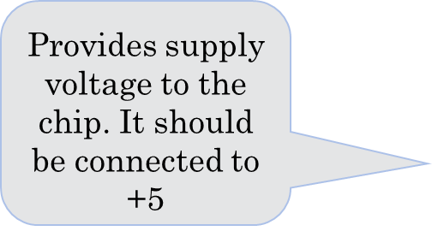
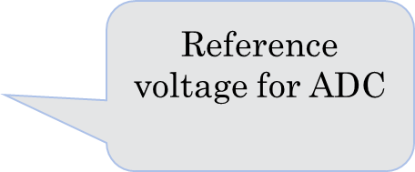
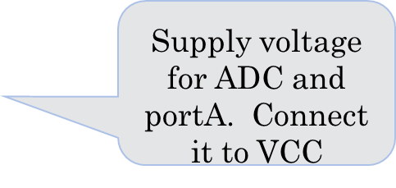
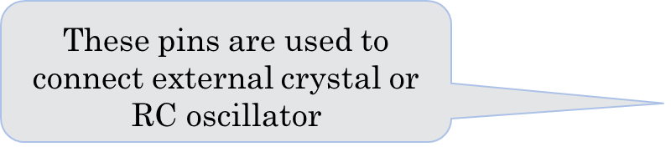
Cntd…

Slide 30
Cntd…
VCC & GND: digital supply voltage for ATmega32. Operating voltage 2.7-5.5V. Should never exceed 6.0V.
XTAL1 & XTAL2: connections to crystal on-chip oscillator for generating internal clocks. typical values for C1,C2 are 22pF.
RESET: a low level on this pin for longer than 1.5 nano second length will generate a reset. During reset all I/O register are set to their initial value & the program starts execution from reset Vector.
AVCC: the supply voltage pin for ADC . Should be externally connected to VCC.
AREF: the Analog reference pin for ADC. Connect to suitable voltage if external ref is chosen.
Digital IO is the most fundamental mode of connecting a MCU to external world. The interface is done using what is called a PORT.

Slide 31
Cntd…
A port is the point where internal data from MCU chip comes out or external data goes in.
Most of the PINs are dedicated to this function and other pins are used for power supply, clock source etc.
ATMega32 ports are named PORTA, PORTB, PORTC, and PORTD.
PORT A (PA0-PA7): serves as an 8-bit bi-directional digital I/O port. Port A can be programmed to serve as alternative Function as analog input for the ADC.
PORT B (PB0-PB7), PORT C(PC0-PC7) and PORT D(PD0-PD7) are serves as 8- bidirectional digital I/O port with the optional internal pull-ups.
They are tri-stated when reset and can be programmed to serve as alternative function.

Slide 32
                Reading Assignments
Assembly language Programming with ATmega32 Instruction Set(Lab session)
Programming in C to Interface peripherals, Interrupts, ISR and Timers(Lab Session)

Slide 33
End of Chapter Two
Any Question ???

